Slide 1
The GED
Separating Facts from Gossip
Notes:
In the continuing debate over public education, the GED is often portrayed by pundits as “proof” that young people are failing to do their work or that schools in general aren’t doing their job. Many people think the GED is a way of saying that a student who does it is inferior or dumber than a high schooler. Very seldom does anyone acknowledge the GED for what it actually is: a diploma signifying a person’s high-school literacy—that a person is able to read, write, and compute in a way necessary to interact in the modern world.

Slide 2


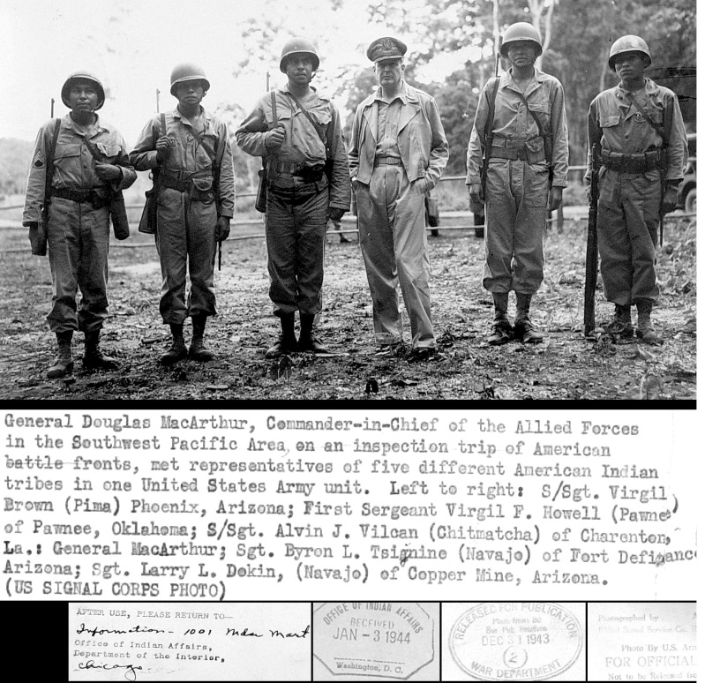

A short History
Invented 1946
Summarizes high-school literacy (reading, math, writing)
Test constructed so that only students achieving a ‘C’ average or better can pass it.
Completers better prepared for college than most high schoolers.
Notes:
The GED (General Education Development program) was first created during World War 2. Although Public Education had been run by states on their own (and many systems were good), it wasn’t until the war came that the U.S. realized how widespread the literacy problem was among adults. Up until then, for example, only about half of American kids on average finished high school. Those from rural areas were notorious for being under-educated. So, as the draft got under way the U.S. military was determined to have a way to make sure every soldier knew the basics of reading, writing, and counting.
Eventually the GED was also seen as a way to help returning GIs get credit to help them get into college quicker. It aimed to recognize adults for what they already knew and could do, rather than how much time they had spent in a classroom.
A key factor of the test is it’s designed to defeat nearly half (45%) the average senior high-school class. That is, high schoolers who earn less than a 2.0 would not be able to pass it. By contrast, most public high schools today routinely graduate seniors with less than a C average.

Slide 3





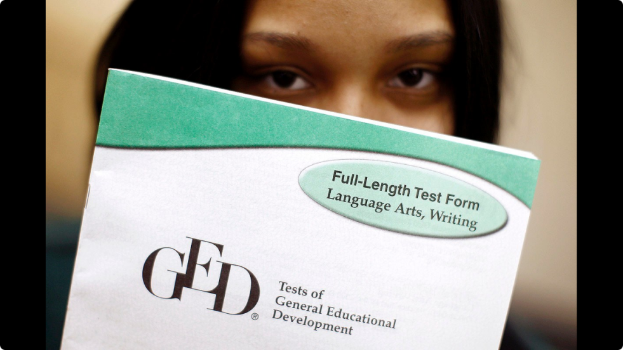
What it’s been
17 million graduates
< 39 million estimated without diploma
More than 96% of employers see no difference between a GED and a high school diploma; 95% of colleges see them as equivalent (2011)
Total UMUT graduates to date = 175+
In 2012-2013 UMLC graduated 9 adults. Another 12 by December 2013. (40% continuing to college)
Since new GED launch in 2014 = 1 adult at UMLC.
Notes:
Since then, more than 17 million Americans have earned a GED—about 7% of the nation’s adults. However, this number still represents less than half of those who need it, partly because government has never devoted much funding to it.
For example, in 2009 about $400 was spent per each GED student in Colorado—and these were federal dollars only, because Colorado is the only state in the nation that refuses to support adult education in any way. Meanwhile Colorado was spending close to $9,000 each for each pupil in its public schools.
The starvation of funds has meant an overwhelming shortage of classrooms for GED students in Colorado--available programs here can accommodate only 3% of the adults in need.
[Colleges receive federal funding (sans student tuition) through government subsidies and tax breaks averages $15,000 per student annually.]
Nevertheless, the GED has made a big impact here. Most have gone on to permanent jobs or embarked on college. In the 2012 school year and following quarter, we had 21 successful GED graduates.

Slide 4
What the GED is and Is NOT
It is NOT a substitute for a high school experience
It IS proof of EQUIVALENT ability or knowledge
It is NOT required to work, in many places
It IS the same as a high school diploma to 96% of employers
It is NOT required for entry into many junior colleges
It IS required if you want to get financial aid for college
Notes:
Increased attention in recent years has led to more debate about the GED, but all the research agrees on the following…
The big difference is not academics. It’s grit, stick-to-it ness. It simply takes more time and energy to complete a GED or alternative diploma than it does to finish high school. Why don’t more kids finish high school, then? The reports on their feedback indicate that they are frustrated and bored, disconnected.

Slide 5
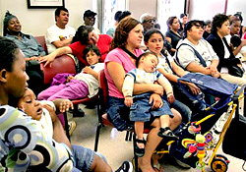


Why it matters
Not getting a state-authorized diploma or GED means…
= 4 times greater dependence on welfare, poverty relief, etc.
= $10,000 less average annual earnings
= 4 times increased health risks & chronic disease, hospital visits, etc.
= 3 times increased chance for criminal activity & jail time
= $625 million per person lost, in tax revenues + government savings
Notes:
Consider for a moment why a GED or equivalency diploma is so important—it’s not that it guarantees high income or stability, but that it’s a safety net preventing worse things from happening…

Slide 6
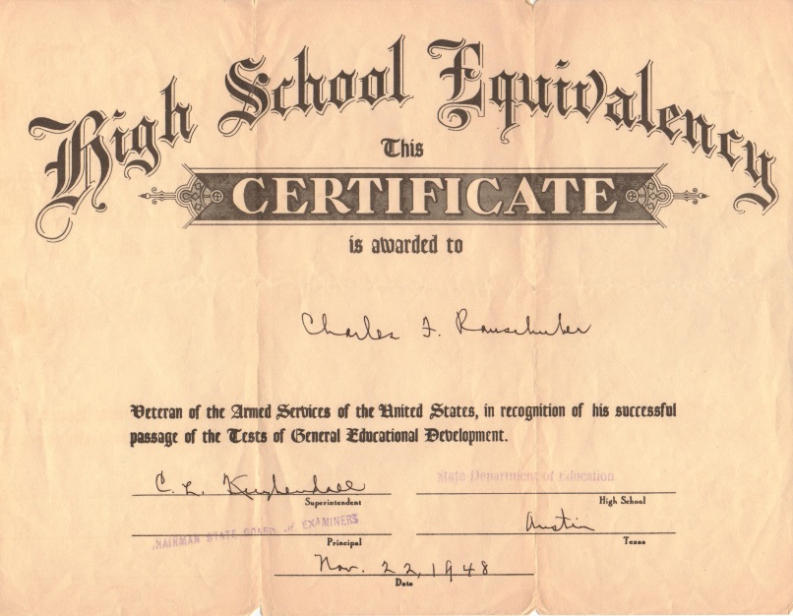
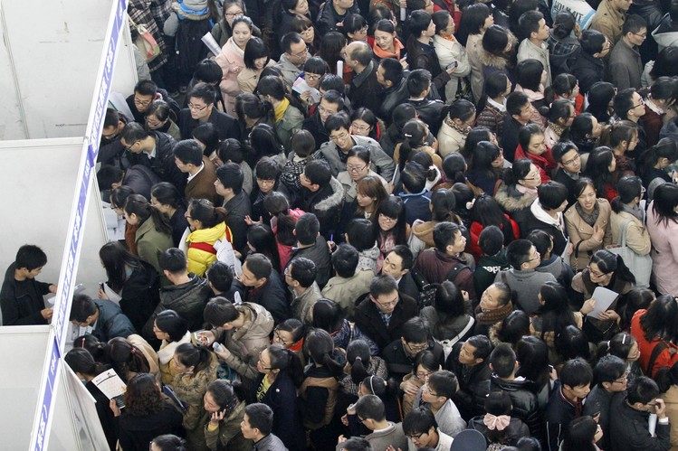

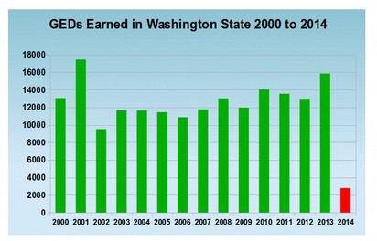


What happened?
GED scheduled for update 2012 (10 year cycle)—then… postponed:
NCLB disaster = High School Dropout epidemic of 2009-2011
Corporations put in charge of education testing (Pearson-Vue)—raise prices, online only
Widespread campaign to discredit GEDs
Results…
Completion rate before 2014 = 85% With new GED fell to 16%
Ute Mountain pass rate before = 63% After = 9%
Notes:
Of course, by now, everyone know that the GED has fallen on bad times. What caused this?
Well, in brief, a number of things happened all at once, just as GED officials were preparing a routine revision in 2012…
NCLB had resulted in massive financial and operational failures for public schools
More than a million kids were dropping out each year, about a third of seniors, many of them turning to GED instead of their high schools
State Departments of Education, principals, etc., began screaming for ways to stop the kids from leaving their schools
Private corporations at Congress successfully lobbied for “owning” the official test systems
So the GED revision was “interrupted” for an overhaul…
A widespread campaign then emerged to completely discredit the GED, in preference of high school completion, despite historical facts
And the intention of the GED revision, therefore, became to make it so hard that nobody would try to do it. Thus stopping kids from leaving high school, they hoped. It became a college-entrance test, not a high-school summary.
The results speak for themselves… overnight, GED completions fell 70%, and Ute Mountain students practically stopped coming.

Slide 7
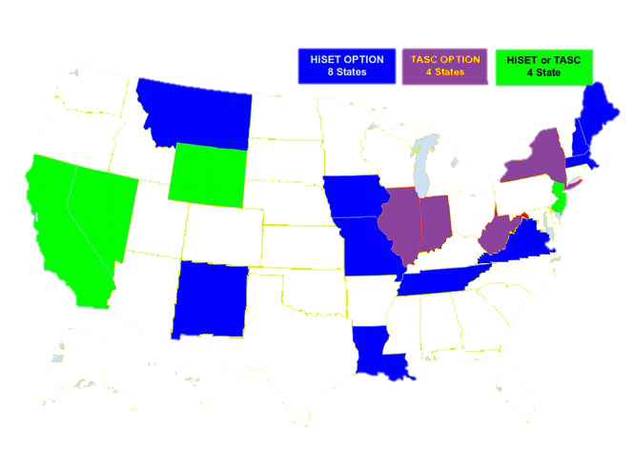
Ten States have dropped the GED
Another FIVE have installed “alternative” exams, such as the HiSET.
This after only ONE year of the new GED
Notes:
By 2015, after only a year, states began repealing the new GED or putting in other alternatives to it.

Slide 8
Results of HiSET pilot at umlc (December 2015-March 2016)
GED (2015) |  |  | HiSET
# students testing | % passing tests |  | # students testing | % passing tests
16 | 48% |  | 12 | 65%
 | $1,262 (no retakes) |  |  | $600 (incl. retakes)
Notes:
To see how it might work here, the Learning Center started piloting HiSET instruction and testing last fall. We wanted to see if outcomes would be any better for average students here.

Slide 9


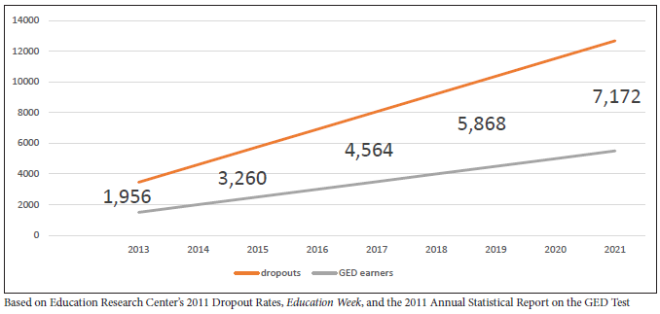
risks
And high school dropouts are not going away…
Despite massive problems it’s caused, Colorado Dept. of Education is only grudgingly responding…
2014 GED rate
Notes:
We want to install HiSET as a regular option for high school achievement at the Ute Mountain Ute Tribe.
With the HiSET we intend to have more people passing and gaining their high-school equivalency credential. At the same time, we’re expecting that more credentials won’t solve the ongoing problems with public school legislation and authorities.

Slide 10
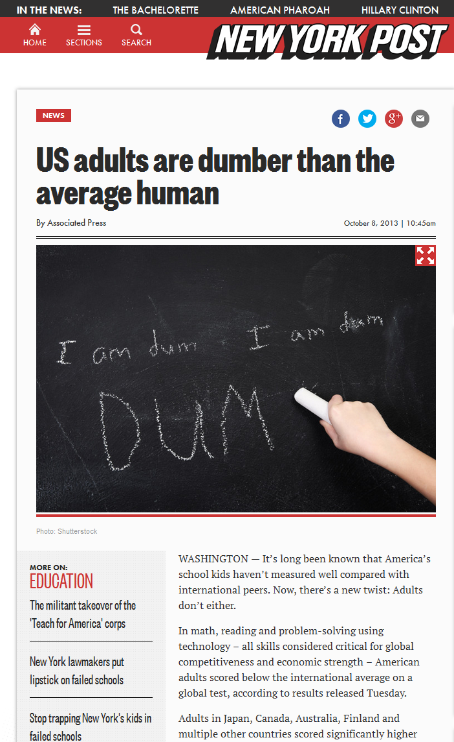

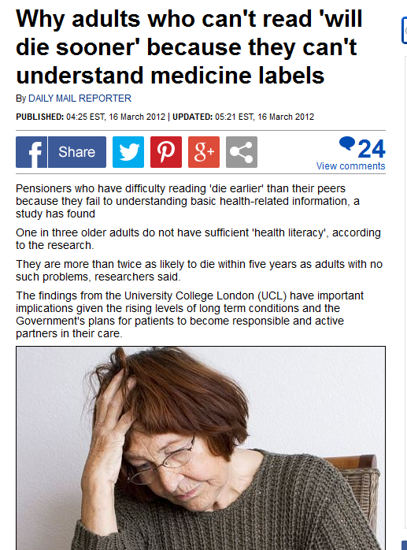
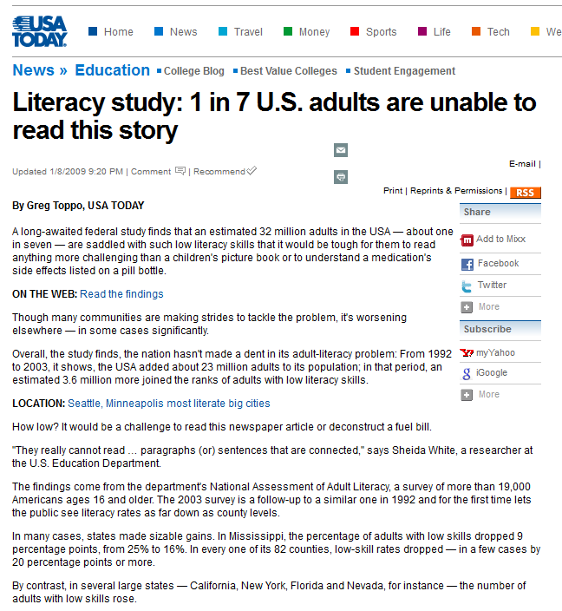

risks
A high-school diploma still doesn’t prove proficiency—93+ million U.S. adults still not literate, some WITH a high school diploma in hand
Although equivalent, neither GED nor HiSET will guarantee a good living wage by itself
Both high-school graduates and HiSET/GED completers HAVE to gain more in order to get decent-paying jobs
Notes:
As President Obama said eight years ago, a high-school diploma is no longer enough. So, the risks we see for our HiSET or GED education here is that students will need a lot more to be truly successful.

Slide 11
What we’re doing already
Consistently petitioning BIE for broader literacy funding
Asking state & federal officials, school administrators, etc., to support not denigrate GED/HiSET students
Establishing alliances with area providers (nonprofits, Colorado Workforce, Southern Ute Education)
Raising public awareness through media, special events, direct contact
Expanding classrooms to serve all reservation adults, including dropouts
Writing, creating, and customizing curriculum to improve outcomes
One-on-one advising and tutoring
HiSET & GED exam preparation, test registration and payment handling, and pre-testing
Helping students obtain GED/HiSET and high school transcripts
Notes:
In addition to our HiSET experiment, our Adult Education Program has continued to strive in many areas… including:
Pushing the Bureau of Indian Education for greater literacy support
Conferencing with Colorado and federal officials, school administrators, etc., to help not denigrate GED/HiSET students
Building alliances with peer agencies, including the Southern Ute Tribe and other nonprofits
Raising awareness and expanding our instruction and services to all adults at the reservation
Customizing our curriculum for better student results
And continuing to walk students through the registration, payment, testing, and followup procedures of GED and HiSET

Slide 12
Action steps
Make HiSET a regular alternative to the GED
Increase the URGENCY of high-school completion at the Tribe
Expand incentives for high-school completion, regardless of age (bonuses, recognitions, early job access, etc.)
Go to a managed enrollment system with Temp Worker Program
Develop a coalition with Southern Ute Tribe’s Adult Education Department, to increase our impact on education policymakers in Colorado
Notes:
With the permission of Tribal Council, then, we intend to immediately act on the following

Slide 13
Proposed for Ute Mountain: add the HiSET alternative
Endorsed by American Federation of Teachers
Authorized by State of New Mexico (Colorado has approved but not installed it yet)
Cost: 66% less than GED
Available test centers: Diné College, San Juan College (January 2016)
Possibility of test center at Ute Mountain? Yes
Impact on BIE adult literacy grant: None
Notes:
In consequence, we are specifically asking Tribal Council to authorize the HiSET as a valid alternative to the GED. Among other positives, the HiSET is much less expensive than the Pearson-Vue GED and fits with our BIE grants, although we are having to provide monthly transportation for students to New Mexico in order to take thier exams there because Colorado remains stalled on implementing it.

Slide 14
Thank You
Scott Baker
Director of Higher Education
Ute Mountain Ute Tribe
Tanya Taylor
Adult Education Coordinator
Ute Mountain Ute Tribe

