Slide 1
Diploma Impostors
The rising number of “online” certificates that are NOT high-school equivalent
Notes:
Our next topic concerns a danger that threatens people here at Ute Mountain

Slide 2
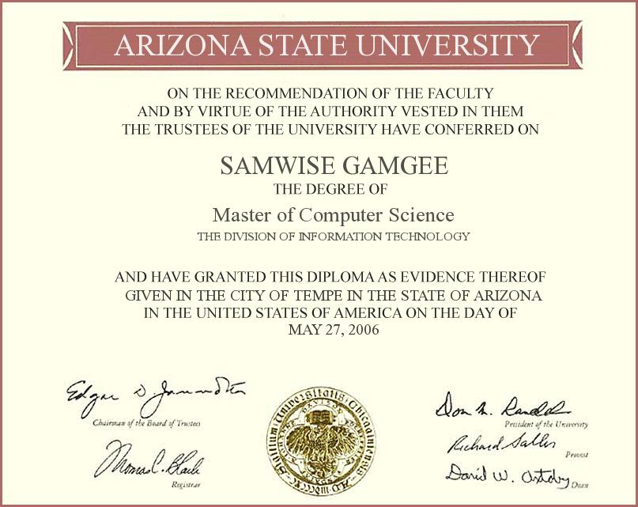
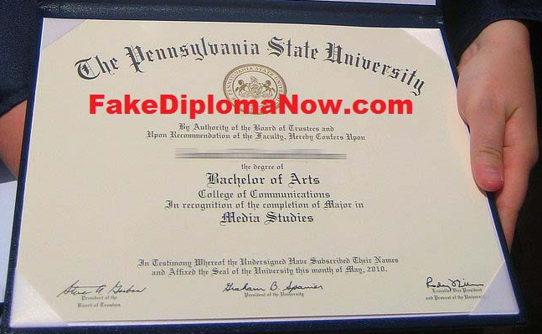
Illegal vs. Legal
‘Impostor’ n. [Lat.]. That which deceives by providing false identity.
Forgeries that pretend to be authentic documents have official standing as illegal—anyone selling them may be prosecuted by law. Documents that appear real, however, but avoid making any claims about what they “are,” can be legal. For our purposes here we call them impostors.
Notes:
This is a form of fraud, by which Tribal members may think they are obtaining a normal high-school diploma but are in fact being “conned” into a fake one. But how is this fraud managing to exist?

Slide 3
Caveat Emptor
Over the Internet, people are buying impostor (fake) diplomas in large numbers.
People do this in order to bypass school or the official exams (like the GED). But they also do it because they believe they’re getting an actual high-school approval.
By law, if you buy something then you assume the risk, even if it isn’t what you think it is. This is the “buyer beware” principle, and how many Imposter Diploma companies continue to operate.
Only a state government’s department of education is authorized to certify a high-school diploma/credential.
Notes:
It’s not just happening here at Ute Mountain… and it’s not just “high-school” diplomas

Slide 4
‘Too good to be true’…?
Impostor diplomas “look like” a person has finished high school, but cause specific problems:
Holder may not be able to read, write, or calculate basic math as needed
Holder may be fired from job for providing “false” information
Holder is denied financial aid for college and other public benefits
Impossible to recover payments
Notes:
The results of being “taken in” by these scams is costly, and misleads people into new problems they didn’t have before

Slide 5
Known Impostors
While it’s difficult to keep track of new websites coming up every day, national and state agencies have tried to maintain lists:
Aberdeen High School
Adison High School
Alford High School
Ashworthsuccess.com
Aspen High School
Aspire High School
Bayville High School
Beacon Falls High School
Belford High School
Capitol High School
Clarmont High School
Columbian Northern
Dalloway High School
Edison High School
Ellenwood Academy
Enterprise High School
Ford Worth High School
GED Options
GEDonline.net
GEDonlinediploma.com
Glacier Online Academy
Heritage West High School
Highschooldiplomaonline.net
Jefferson High School Online
John Adams High School
Kennedy High School
Liberty High School
Lincoln Academy
Lionsacademy.com
Long Island Home Study & East End Home Study
Lorenz High School
Mary Grand High School
Mayflower High School
McFord High School
McHill High School
Metro High School
Must High School
My-GED.com
Nation High School
OnlineGEDDirect.com
Onlinegedexperience.com
Onlinegedfast.com
OnlineGEDPro.com
Onlinegedprofs.com
Onlinegedprofs.net
OnlineGEDquick.com
Paramont High School
PennFord High School
Remington High School
Rochville High School
SanFord High School
South Bristol High School
South City High School
St. Rene Descartes University
Thelincolnhighschool.com
Titan High School
Vencer High School
West Madison Falls HS
Western Heritage High School
WinFord High School
WoodField High School
EDUCATION IS AN UNREGULATED INDUSTRY
Notes:
Both federal and state agencies have tried to track the worst of the online offenders promoting these documents, but it’s hard to regulate the internet. Many of these companies are overseas and not American at all. Here is a current list of known imposter companies—most have already shut down, however, and re-emerged under new names and websites.

Slide 6
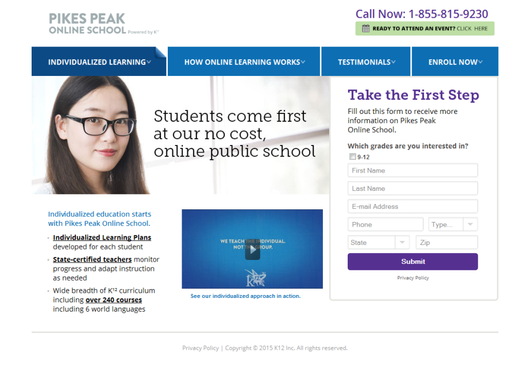
Now appearing
Can you spot the Impostor?
Problem? UMUT members are buying imposter diplomas
Notes:
If you just Google “high school diploma” you’ll get a flood of vendors ready to sign you up. For a fee, of course. At face value, it’s very hard to determine which are real and which aren’t.

Slide 7
Indicators
TRUE: there ARE online High Schools (under State authority) that can give diplomas. There are NO online GED authorities.
Anyone offering a diploma for money, but without (1) specific individual courses, (2) without grades for those courses—that’s a red flag.
You can sometimes be accepted into a community college without a high school diploma—but you will be ineligible for financial aid. Most 4-year colleges require a GED or regular diploma (and they will verify it).
Imposter Diploma companies will often state in their fine print that they “are NOT providing a high-school equivalency.” Too many people don’t read this.
Notes:
There are a very few exceptions to this situation… Most internet browsers won’t know the difference, however.

Slide 8
Solutions
Directors from the Tribal Education Division, Human Resources, and TERO departments are consulting to establish defensive protocols. Some of the recommendations are:
Tribal job applicants must sign an authorization permitting diploma verification and/or provide original transcripts.
Existing employees who hold “impostor” diplomas should be provided a step-by-step process for gaining an authentic state credential.
For example, a probationary period for taking classes, studying, etc., with a timeline (within a year) within which the employee must complete the diploma. Employees who do not comply would face termination.
Tribal members who wish to use Emergency funds to cover expenses of diploma completion must verify the legitimacy of the institution through the Tribe’s Education Division.
Notes:
To protect Tribal members and ensure the actual skills of hirees, we’ve been meeting with leaders to figure out solutions.

Slide 9
Thank you
Scott Baker
Director of Higher Education
Ute Mountain Ute Tribe
Tanya Taylor
Adult Education Coordinator
Ute Mountain Ute Tribe

