Slide 1
College ExPress
Chapter 1: Being Ready

Slide 2
Why Go to College?
What ABOUT college?
Better job
Better income level
Personal independence
Self-reliance
More choices
Enjoy learning

Slide 3
Why Go to College?
The downside…
High costs (avg: $4K annually for CC; $25K annually for 4-year)
High attrition (freshmen dropout avg: 30-60% in Colorado)
Unpreparedness (ProLiteracy estimate: 45% of U.S. adult population can’t fill out a job application)
Increased competition (growing unemployment, etc.)
Rising “standards” of performance (avg. time to degree: 25% more time than 10 years ago)
College a “foreign” learning culture

Slide 4
The secret of College success?
The more you know about yourself,
the better you can take advantage of
education and its opportunities
(note: what “education” meant in the past
may now mean something different)

Slide 5
Why Go to College?
What does “school” mean to you?

Slide 6

Conventional Learning
Public Secondary Education
Pupils = unskilled population (children)
Teacher = master (manager)
Learning follows textbook protocol
Standards & values defined by outside “officials”
Strict “subject-matter” boundaries
Notes:
How we are used to LEARNING will ultimately shape our perceptions and beliefs—and in large part control what we think of any NEW input…

Slide 7


Other Modes of Learning
Apprenticeship
(trade or guild system)

Slide 8
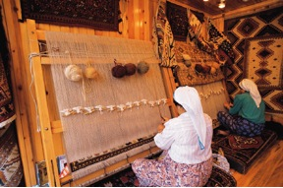
Other Modes of Learning
Apprenticeship
(trade or guild system)
Traditionalist

Slide 9
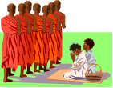

Other Modes of Learning
Apprenticeship
(trade or guild system)
Traditionalist
Monastic
(ecclesiastical)

Slide 10


Other Modes of Learning
Apprenticeship
(trade or guild system)
Traditionalist
Monastic
(ecclesiastical)
Private
(homeschooling)

Slide 11
Other Modes of Learning
Apprenticeship
(trade or guild system)
Traditionalist
Monastic
(ecclesiastical)
Private
(homeschooling)
Adult Learning
Adult Learning
Collegiate or adult learning
(L. collegium "community, society, guild”)
Students = peers in a shared enterprise
Teacher = facilitator (coach)
Learning develops from discussion & collaboration
Values defined by everyone in room; standards, by each
Creative overlapping of knowledge

Slide 12
Other Modes of Learning
Adult Academics:
Communities Interacting
Apprenticeship
(trade or guild system)
Traditionalist
Monastic
(ecclesiastical)
Private
(homeschooling)
Adult Learning
When individuals act together, they each bring complementary insights that in turn enhance everyone’s understanding.
Notes:
Exercise: multiple intelligences worksheet

Slide 13
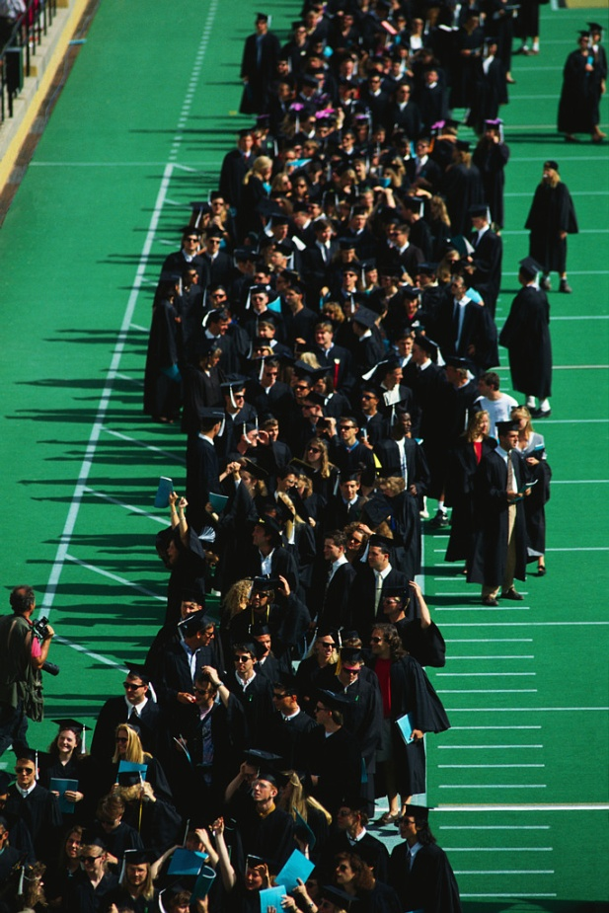
Why Go to College?
Because:
You become more than you were before…
more than “yourself”
more than “one”
more than just a “worker”
You’ve heard that a group is more than the sum of its parts… in the same way, the uniqueness of the learners together makes each one larger in understanding than before. This is what’s so special about ADULT learning: people grow by absorbing new, different views.
IT’S NOT YOUR DEFICITS
BUT YOUR ASSETS
WHICH DETERMINE EVERYONE’S SUCCESS

Slide 14
Why are most of us not ready?
Reason 1: the Cultural Divide
High School
Cliques
Getting it over with
College
Intense, highly focused
Complex information

Slide 15
The U.S. Education System
Private schools
Public schools
Adult Education
Higher Education
(college)
Academies
(military)
Employment training (vocational)

Slide 16
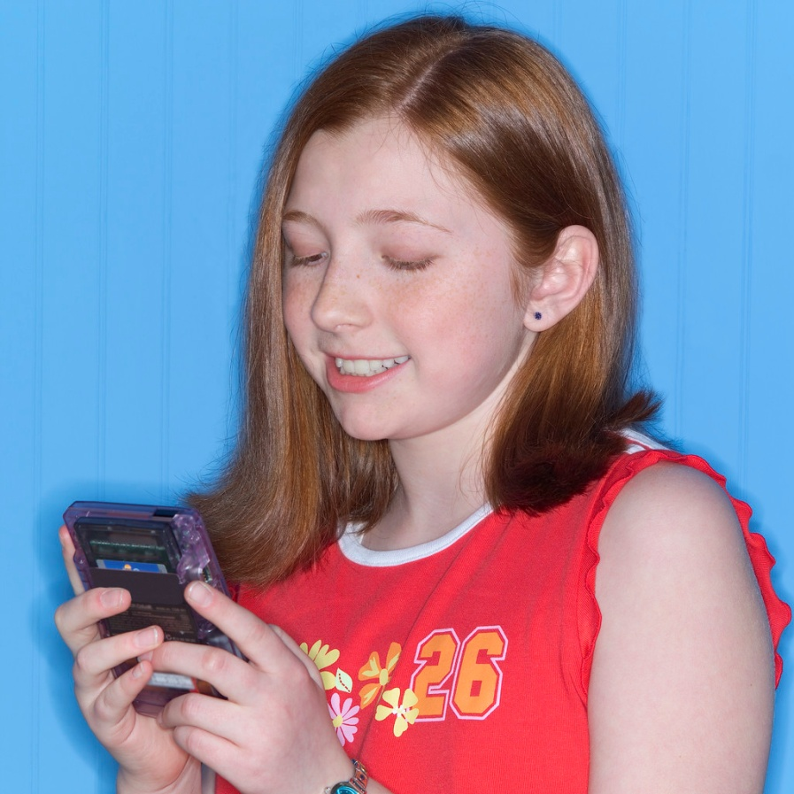

High school or College?

Slide 17
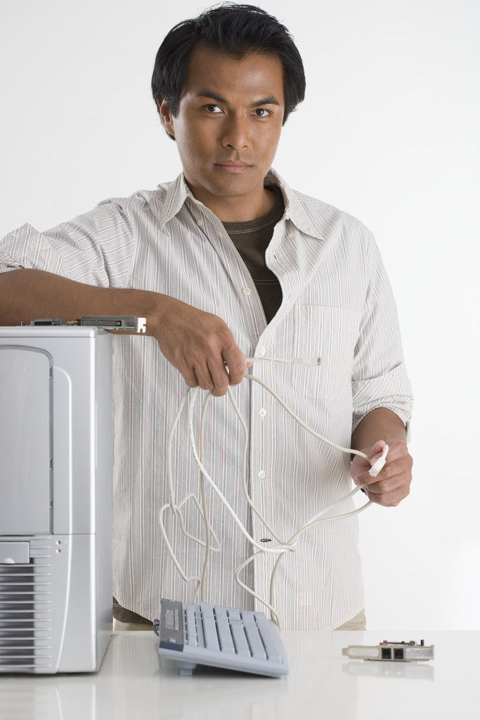

High school or College?

Slide 18
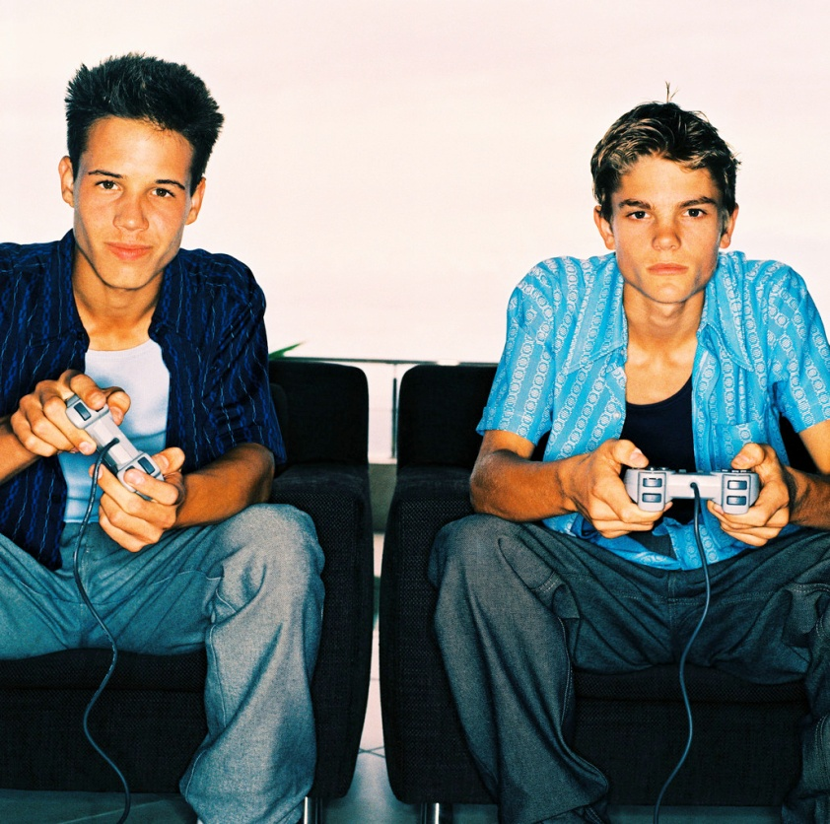

High school or College?

Slide 19
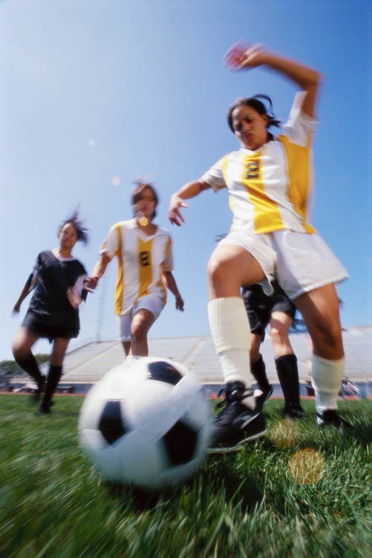

High school or College?

Slide 20
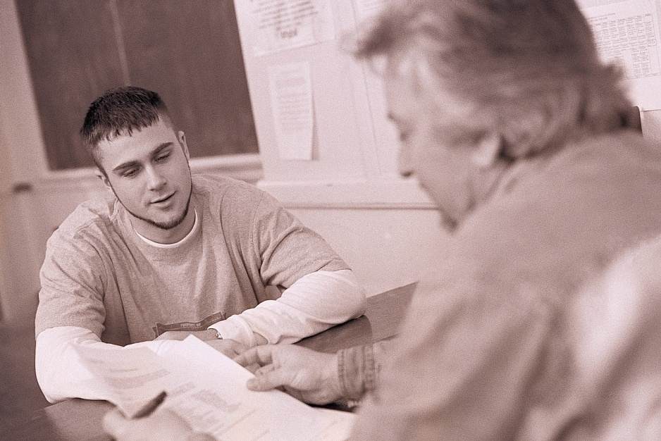

High school or College?

Slide 21

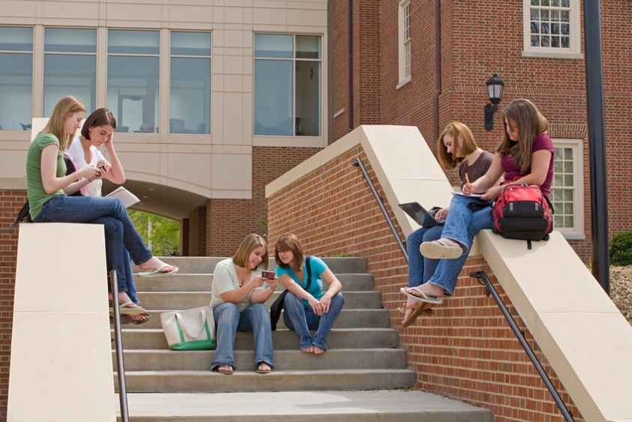

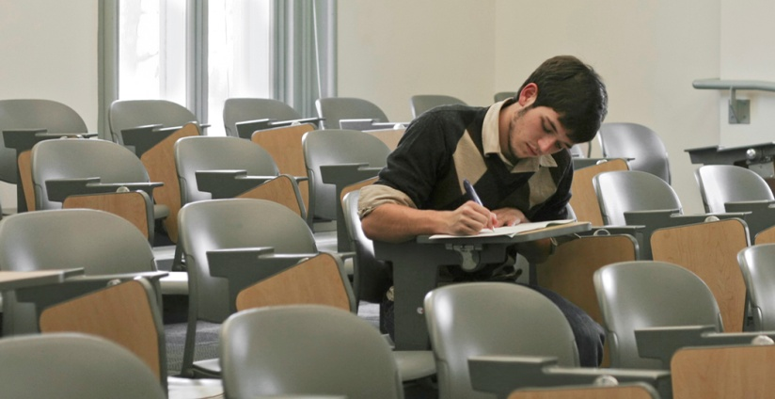

High school or College?

Slide 22
The Cultural Divide?
High School
Suit up, show up
Keep within bounds
External similarity
Follow the pack
Obey, conform
College
Produce original ideas
Push the “edge”
Internal difference
Go it alone
Create, be unique

Slide 23

So, what makes you Unique?
How do you see or do things in ways that others might find compelling?
What do you bring to the table to help inspire new ideas?
What background or experience might be out of the ordinary for others?

Slide 24
What can college accomplish for you that you could not obtain from some other source?
After graduation, what might be the difference in who you are?

Slide 25

Understanding who you are helps you figure out where you are in your educational journey
Am I READY for college?
How will I be received?
What difference will it make?
What’s expected of me?
Notes:
TESTS are the least effective way to know “where you are” in your education, let alone where you’re going.

Slide 26
Understanding who you are helps you figure out where you are in your educational journey
Am I READY for college?
How will I be received?
To be in control over your identity, to have power in saying what you can do or what destiny you fulfill, you can’t let others choose it for you. You must own yourself and your education.
What difference will it make?
What’s expected of me?

Slide 27








Understanding who you are
Multiple intelligences
(how info “uploads” best)
Personality or mode of interaction
Personal background, culture and experience
Career aptitudes

Slide 28
Understanding who you are
I am unique in how I absorb and process new ideas, due to…
Because of my upbringing, I tend to think of __________ as something which is _________....
The way I respond to people or situations has to do with my tendency for…
The things I’ve done and experienced so far suggest I might have a knack for…

Slide 29


Taking Charge
It’s okay to be unsure of your destination, but you have only yourself to blame if you get lost. At least ask.
--Anon

Slide 30
College ExPress
Chapter 2: The Map

Slide 31
Going to College is a bit like going to a new country
It takes a while to get used to…
and at first can be very confusing!

Slide 32
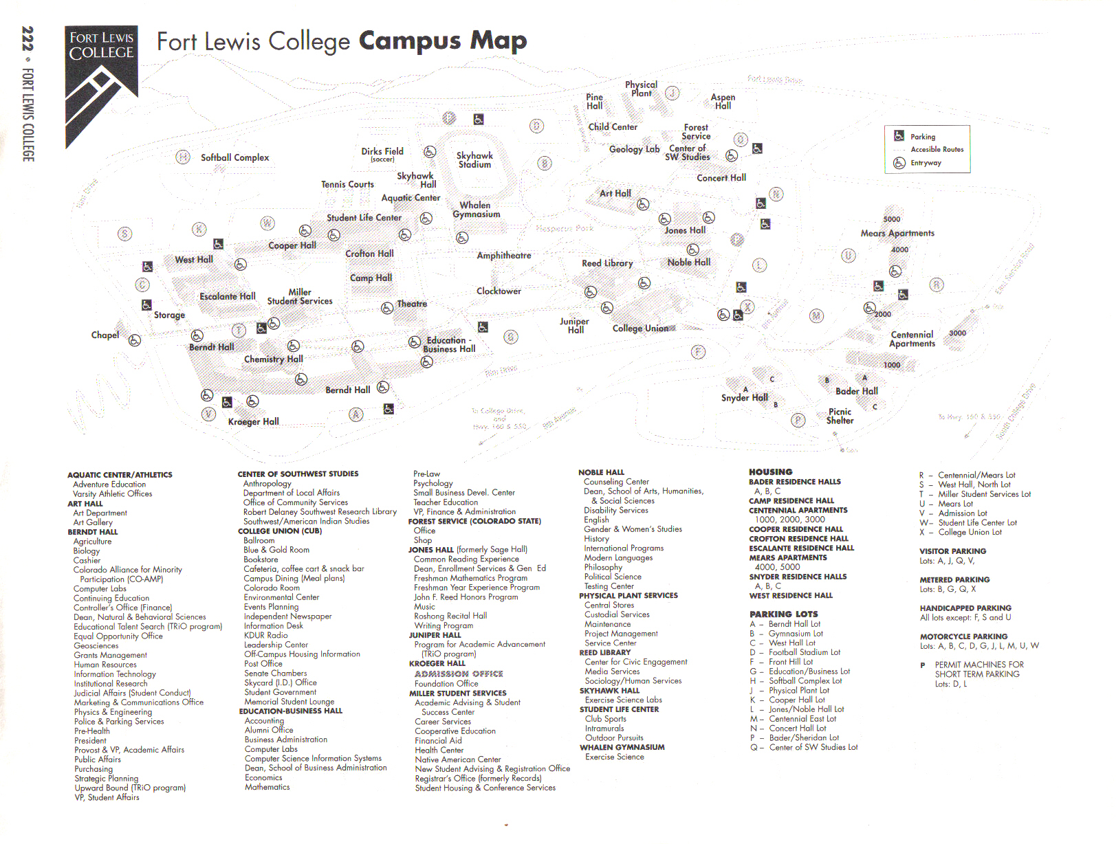
The Topography of College

Slide 33
Sample campus
dining
advising
Special programs:
Clubs/ Org’s
Equal Opp. prog.
Hispanicos salud
Native Amer. center
etc
clinic
Student Union
labs & tutors
Registration
childcare
Commons
housing
Financial Aid
      Student regulations
      Transportation
      Payments
      Academic standing
      Career center
      Extracurricular
Bookstore
Student Services
Admissions
Planning
Gymnasia & stadium
Administration
security
maintenance
Records (registrar)
Operations
Academic dept
Lecture halls
Lecture halls
libraries
Personnel
Comptroller
Purchasing
Public relations
Safety
Etc.
research center
Academic dept
Lecture halls
Lecture halls
concert halls
Academic dept
auditoriums
Academic dept
Extension or continuing learning
Lecture halls
Lecture halls
Lecture halls
Lecture halls

Slide 34
The Topography of College
Housing
Services
  Administration
  Admissions
  Deans’ Offices
  Registrar (records)
  Bursar (cashier’s office)
  Advisors’ offices
  Etc.
Bursar
Registration
Bookstore
Student Services
Recruitment
Admissions
Planning
Alumni
Administration
Deans’ Offices
Records (registrar)
Operations
security
President
Chancellors
Provosts
Deans
Chairs
Directors
supervisors
.
.
maintenance
Advising
Personnel
Comptroller
Purchasing
Public relations
Safety
Etc.
Career
Services
Admn
Educ
Life
Public

Slide 35
The Topography of College
Registration
Financial Aid
(revenue)
Bookstore
Student Services
Admissions
Planning
Administration
Records (registrar)
Operations
security
maintenance
Personnel
Comptroller
Purchasing
Public relations
Safety
Etc.
Admn
Educ
Life
Public

Slide 36
The Topography of College
Financial Aid
(revenue)
Admn
Educ
Life
Public

Slide 37
The Topography of College
  Educational Function
  Classes
  Academic departments
  Degree programming
  Faculty consulting
  Curriculum development
  Libraries
  Athletics
  Laboratories
  Technology Complex
  Research programs
  Tutoring/learning support
  Award Programs

Slide 38
The Topography of College
  Educational Function
  Classrooms
  Academic departments
  Degree programming
  Faculty consulting
  Curriculum development
  Libraries
  Athletics
  Laboratories
  Technology Complex
  Research programs
  Tutoring/learning support
  Award Programs
Academic departments are driven by faculty committees (i.e., professors, usually tenured not adjunct), directed by a Department Chair.
The classes, grades, etc. that will accomplish a Degree or fulfill a “Program” is determined by several forces—but typically only a Dean (the “principal” of the School which houses your academic Department) has the power to alter or amend its parts.
Faculty are mainly the front-line of contact with students—they teach the classes, hold office hours, work on sharing with each other, design or reshape curriculum in order to better meet goals or improve learning, counsel students on just about everything, coordinate resources, etc.
Notes:
What this means is that if you have questions about what classes your Major requires, what options it allows, or what study resources you might need for a course, the DEPARTMENT is the place to go. If the Department people can’t seem to help, you want to make a change, or their rules seem unfair, the DEAN is the one to address. Unless FACULTY serve an administrative role, there’s almost nothing they can do to adjust the system. They can re-present the material, rearrange time, coach, inspire, warn, make contacts, give ideas, talk, and grade your work.

Slide 39
The Topography of College
  Amenities for Students
Student Union
Budget services
Ombudsman (conflict help)
Eateries
Recreation/Leisure activities
Study Abroad programs
Employment bureau
Housing bulletin
Childcare
Career Placement
Disability Services
Clubs
Chapel
Computer Services (email, etc.)
Equal Opportunity Office
Psychological /medical services
Transportation Program
  Amenities for Public
Civic Events & Organizations
Museums
Concert hall
Institutes & Research Centers
Policymaking “think-tanks”
(government, etc.)
Public Lecture or Forum series
Extension education
  Educational Operations
  Classrooms
  Academic departments
  Degree programming
  Faculty consulting
  Curriculum development
  Libraries
  Athletics
  Laboratories
  Technology Complex
  Research programs
  Tutoring/learning support
  Award Programs
Notes:
What this means is that if you have questions about what classes your Major requires, what options it allows, or what study resources you might need for a course, the DEPARTMENT is the place to go. If the Department people can’t seem to help, you want to make a change, or their rules seem unfair, the DEAN is the one to address. Unless FACULTY serve an administrative role, there’s almost nothing they can do to adjust the system. They can re-present the material, rearrange time, coach, inspire, warn, make contacts, give ideas, talk, and grade your work.

Slide 40
The Topography of College
Key Domains or Branches of the College Community
Administrative
Admissions
Functional
Classes
Amenities--students
Student Union
Amenities--public
Civic Events & Organizations
Financial Aid Office
Bursar (cashier)
Bookstore
Registrar (records)
Outreach & PR depts.
Deans’ Offices
Faculty Committees
Personnel
Advising
ID/Permits Office
Career services/work-study
Housing services
Testing Center
Special Needs Office
Planning Office (growth)
Physical Plant (custodial, etc.)
Provosts, Trustees & President’s Offices
Academic departments
Degree programming
Faculty consulting
Curriculum development
Libraries
Athletics
Laboratories
Technology Complex
Research programs
Tutoring/learning support
Award Programs
Budget services
Ombudsman (conflict help)
Eateries
Recreation/Leisure activities
Study Abroad programs
Employment bureau
Housing bulletin
Childcare
Career Placement
Disability Services
Clubs
Chapel
Computer Services (email, etc.)
Equal Opportunity Office
Psychological /medical services
Transportation Program
Museums
Concert hall
Institutes & Research Centers
Policymaking “think-tanks” (government, etc.)
Public Lecture or Forum series
Extension education
Athletic events

Slide 41
Why so BIG?
College
Originates in the monasteries of medieval Europe: focused on training the Christian clergy, maintains libraries, Latin literacy. First effort to canonize knowledge in “liberal arts.”
Over time, is subsidized by state and oriented to upper-class interests (wealth, power, etc.). A generalist or cosmopolitan approach to knowledge.
Main intent: to provide context for socializing or networking young men of the upper class. A kind of proving ground for future leaders.
University
Originates in central Europe in the 1800’s, due largely to scientific intensification and specialty.
Becomes the haven for generating “experts” in given fields (e.g., botanists, doctors, chemists, etc.)—origin of the “major.”
Main intent: to develop research and expand scholarship in the specific sciences (later, in arts). Creates a distinct professional class.
Was still intended for the privileged or gifted few

Slide 42
What’s “College” for, then?
The role of higher education in America today:
Builds higher-level thinking (makes learners more adaptive, diverse)
Specializes human skill (i.e., expertise)
Professionalizes people (a kind of licensing or authorizing network)
Research & technological innovation
“Think tanks”—advanced problem-solving, knowledge creation
Sophistication (broader exposure to “world”)
Serves everybody

Slide 43

What else is College?
A business—profitability is crucial
        An institution—must meet accreditation standards set by authorities, follow state/fed rules to get $ubsidies
An arena of public debate—what to allow or forbid, intellectual freedom, opinion battles, etc.
A community of ideas & authorities

Slide 44
College ExPress
Chapter 3: Your Route

Slide 45
The Post-secondary Menu
2-year schools
VS
4-year (or more) schools
Community colleges
Vocational schools
Technical institutes
Certifications
Associate degrees (AA, AS)
Trade testing/licensing
Colleges (public/private)
Universities
Undergraduate degrees (BA, BS, etc.)
Graduate degrees (Masters, PhD, etc.)
Post-graduate courses

Slide 46
The Post-secondary Menu
Vocational (2 years’ program) |  | Academic (4 or more years’ program)
Technical School | Community College | College (undergraduate) | University (graduate)
Certification and/or licensing | Associate degree (AA, AS) | Bachelor’s degree (BA, BS) | Bachelor’s, Masters, and/or Doctorate (BA/BS, MA/MS, PhD.)
construction, electronics, technical repair, equipment operator, welding, culinary arts, et al. | academic fields, paralegal, business mgmt., administrative asst., computer programmer, et al. | English, Political Science, Art, Business, Psychology, Economics, Culture Studies | same as College but more specialized (e.g., Literature, Linguistics, Finance)

Slide 47



Post-secondary Learning Paths
(routes of entry from high school)
Certificate * * * Associates * * * * Bachelors * * * * * Graduate
entry
College/University
Community college
job
job

Slide 48
College “builds” knowledge “upward”
Prerequisites
General Ed courses
Major courses
The Degree
College entry level
Remediation

Slide 49
Transferability
Prerequisites
General Ed courses
Major courses
+ 2 years
more
= Four-Year
Program
(Bachelors
degree)
Two-Year
Program
(Associate degree)

Slide 50
College ExPress
Chapter 4: Paying for the Ride

Slide 51
HOW to
PAY for
IT ALL?

Slide 52

Financial Aid
Federal
Pell Grant
Subsidized Loans (Stafford, Perkins, etc.)
Interest-bearing loans
GI or Veterans benefits
Americorps, US Dept of Health, Dept of Labor, subsidies, etc.
State
Incentive grants (may depend on school chosen)
Family-dependent grants
Other
Scholarships (Tribal, merit, foundational, etc.)
Employer work-study
Occupational grants
www.fafsa.ed.gov

Slide 53
College + Money = ?
Rule #1: college students do NOT live in luxury (you won’t have money to blow).
Rule #2: if you don’t take special care of your funding sources you will lose them.
Rule #3: you are responsible for your cash management, nobody else.
Rule #4: no resource is endless.

Slide 54
Good vs. Bad Financing
Grants
Loans
Grants
Loans
Better
Worse

Slide 55
Your Investment in “Knowledge”
Value of the degree
Learningintensity
Time

Slide 56





The value of college is in building your thinking “muscle”
For example, what humans “know” is always changing…
“There is nothing new under the sun, but there are lots of old things we don’t know.”
    --Ambrose Bierce
Notes:
Everything we know began somewhere else; at the same time, what we know has been re-worked, reconsidered, and rethought over and over to bring ever-new ideas into the world. That is human creativity, and wisdom.
Scholars compel us to rethink or rediscover what we see or experience.

Slide 57
College = Community
Why would anyone need an “academic” community?
Why would sounding “academic” be useful to anyone?
So what, if people realize you’re “from” college?
What’s the advantage (if any) of being seen as a creator of knowledge, instead of just a good reader?
Notes:
There used to be a saying: ‘he’s a college man.’ It meant that the person was different in what he said and did in his affairs—maybe he was more sophisticated, maybe more pompous, etc.
If you imagine ‘college graduates’ as a total group, what does it mean if you belong to it? What do you get or give for your membership?

Slide 58

College as a Community
Why?
To be among people who understand and appreciate You and your ideas, regard you as an equal—
bright, creative, energetic
Being regarded as an Expert… not an amateur--able to absorb and apply the latest information
Being seen as Leader… someone who is “in the know,” who carries power
Being valued as an Innovator… someone who discovers new methods or tools
Notes:
There used to be a saying: ‘he’s a college man.’ It meant that the person was different in what he said and did in his affairs—maybe he was more sophisticated, maybe more pompous, etc.
If you imagine ‘college graduates’ as a total group, what does it mean if you belong to it? What do you get or give for your membership?

